Slide 1
Round Table
By: Madison Lutz

Slide 2
Interactive Children’s Book

Slide 3
Inspiration Links
p5.play Animation style
RPG style
Storybook Narrative
Storybook Cont…
Mini-Games & Interaction

Slide 4
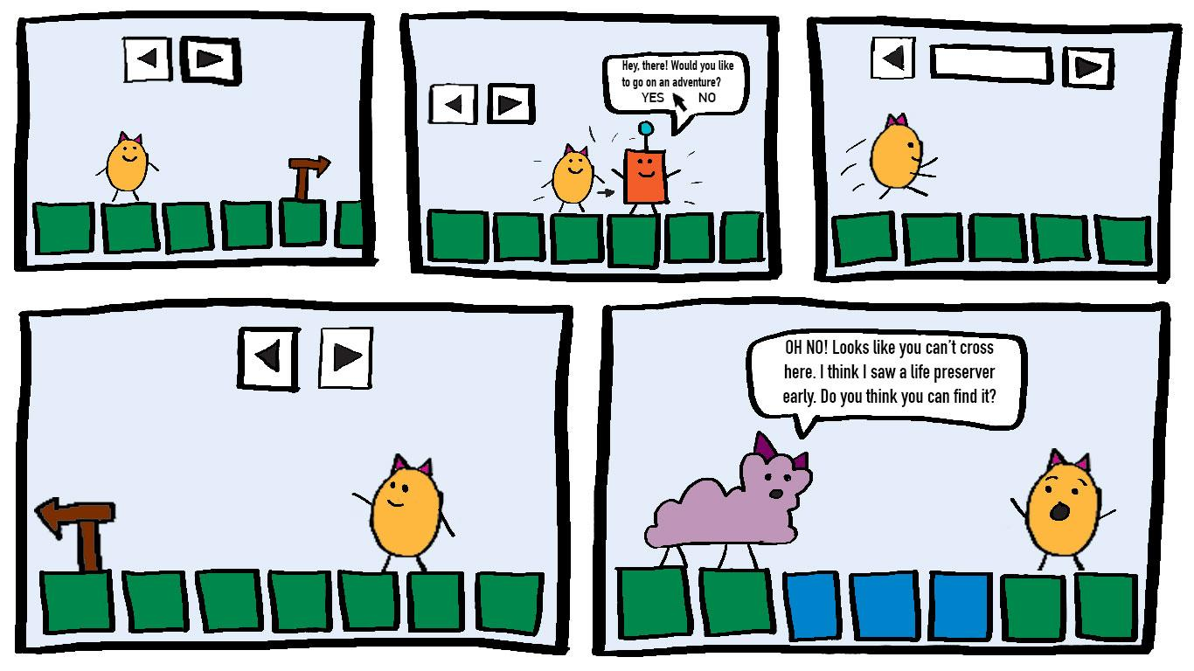

Slide 5
The Dynamics of Light

Slide 6
Inspiration Links
Aurora Borealis
Light as a Wave
Claude Monet
Light and Movement
Assigning Light Value to a Property
Working with Actual Lights

Slide 7
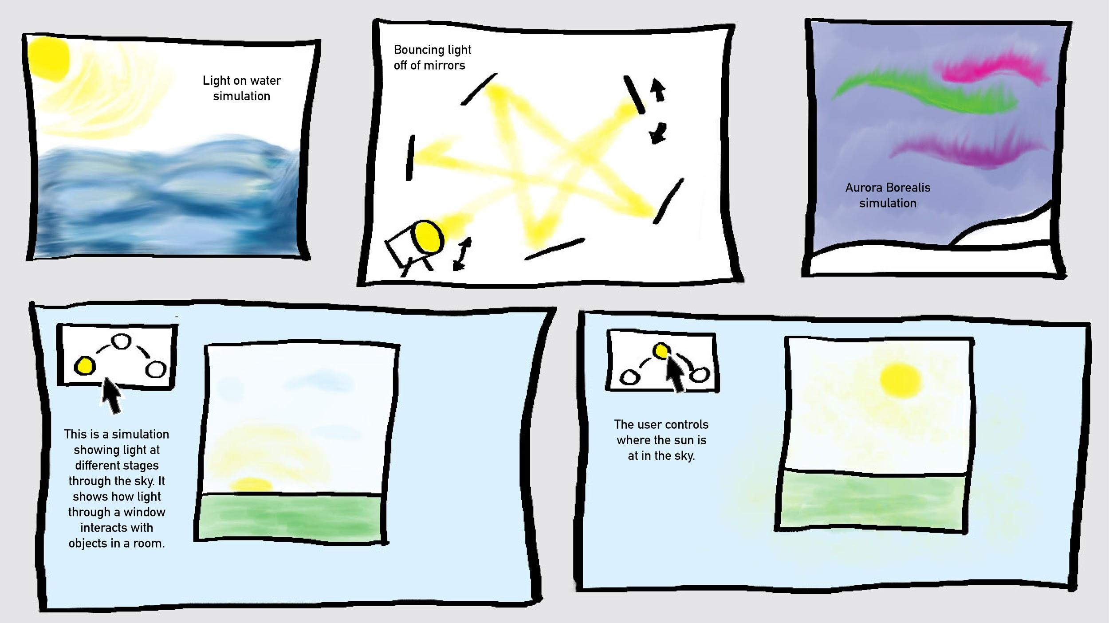

Slide 8
Synesthesia

Slide 9
Inspiration Links
Color Mixing with Sound
Abstractions of Color
User Input

Slide 10
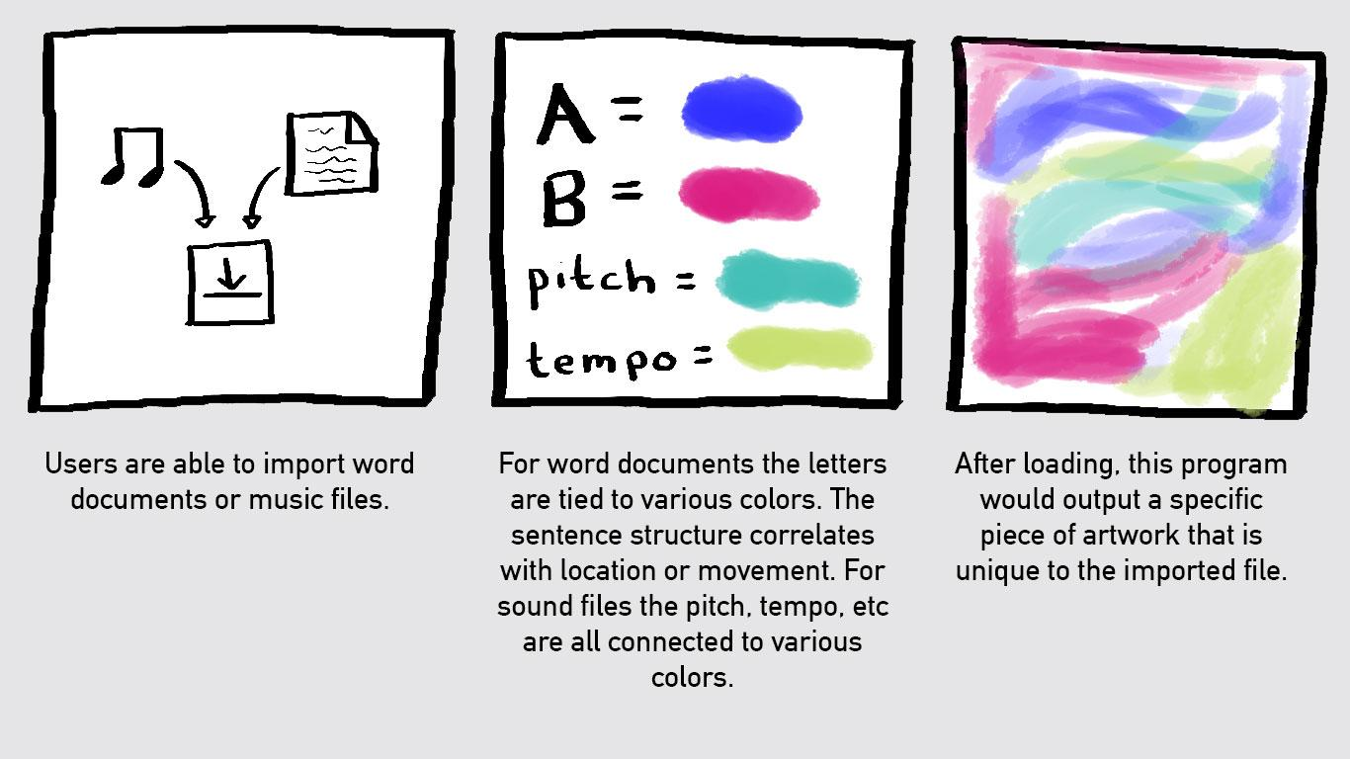

Slide 11
Element Bending Simulation

Slide 12
Inspiration Links
Avatar: The Last Airbender
Interaction with a Large Screen
Motion Capture

Slide 13
